Slide 1
INSTITUTIONS AND LONDON
Cm Géo éco LEA1 semestre 2 2019-2020
M. Bourdeau – UJML3

Slide 2
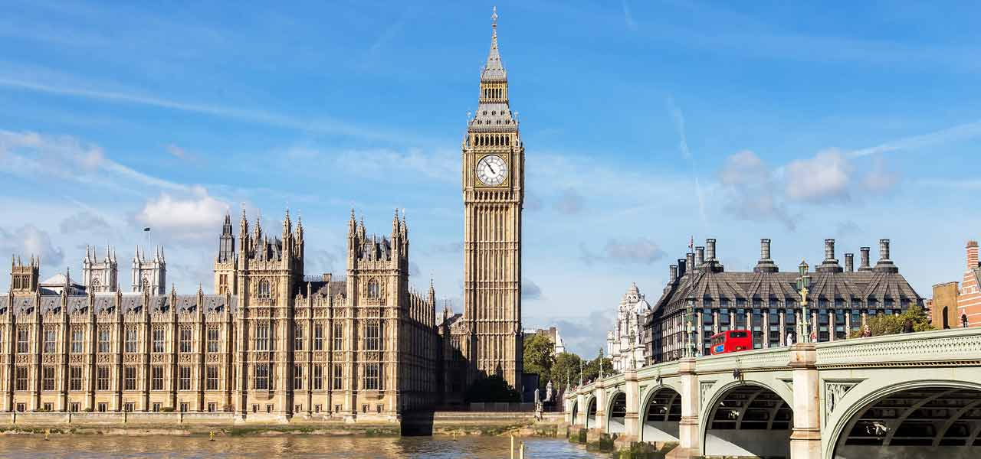
2. London and British Institutions
M. Bourdeau – UJML3

Slide 3
Contents
1a. Westminster & Main Political Parties
2. Whitehall
3. The City
M. Bourdeau – UJML3

Slide 4
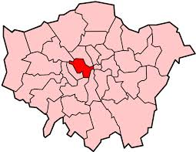
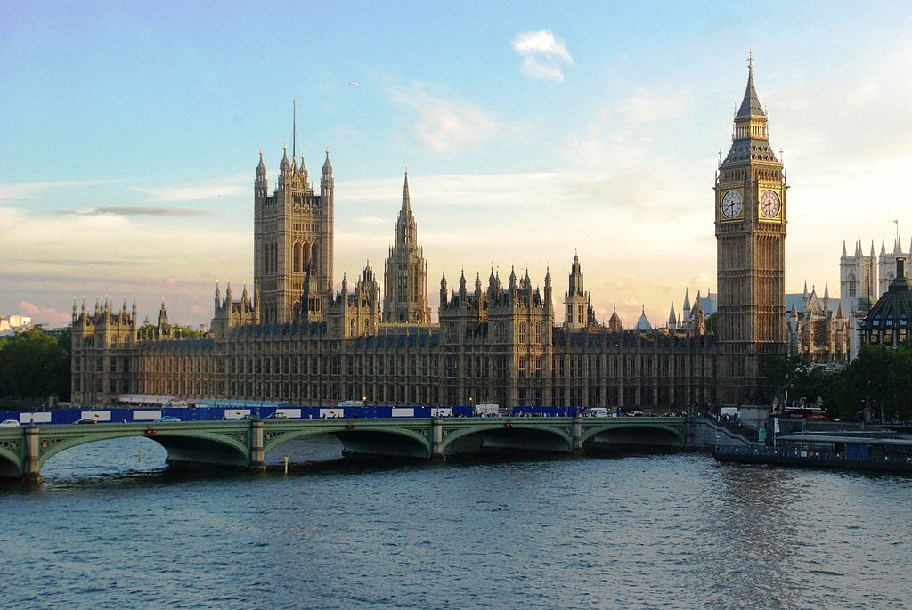
1a. Westminster
London borough
west central London
the Houses of Parliament
Buckingham Palace
The two Houses of Parliament themselves
The parliamentary system known as the Westminster model
M. Bourdeau – UJML3

Slide 5
Westminster Model
The Westminster System - Public Service Commission". www.psc.nsw.gov.au.
A head of state: the monarch
A head of Government: the Prime Minister
An elected Parliament, with one or two Houses
Separation of powers between the three branches of government:
The Legislature (Parliament)
The Executive
The Judiciary
M. Bourdeau – UJML3

Slide 6
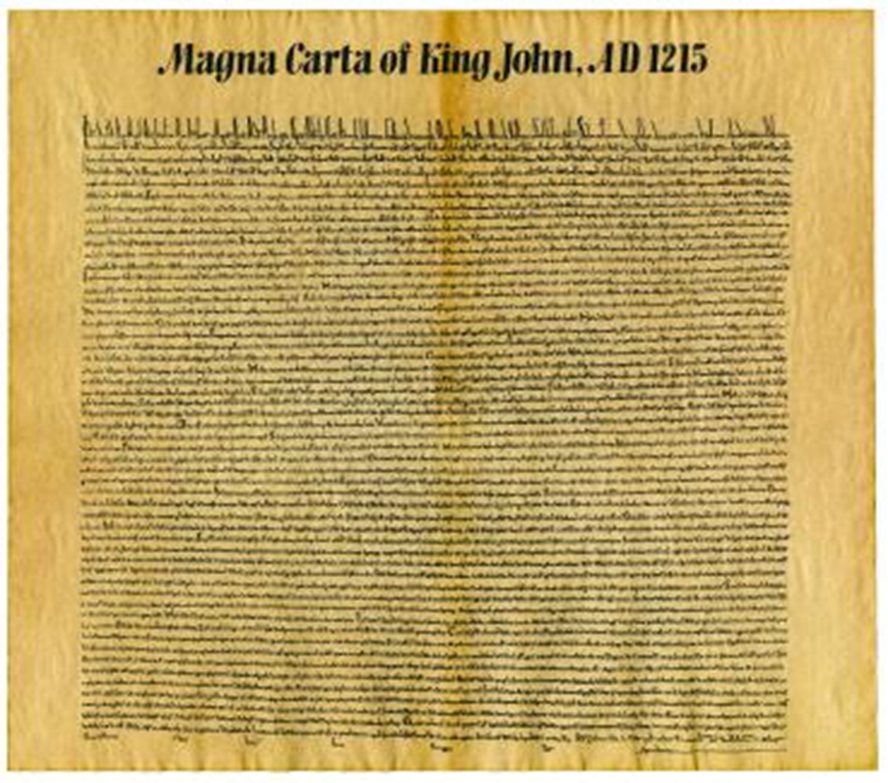
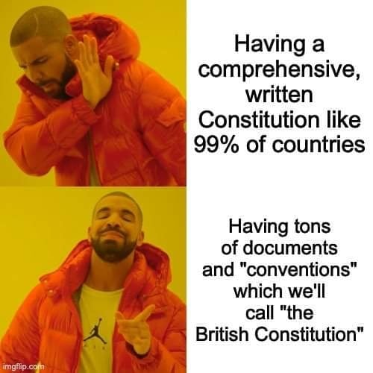
Constitutional monarchy?
British constitution?
Unwritten?
Actually uncodified
Magna Carta (1215)
Bill of Rights (1689)
+ customs, tradition and precedents (case law)
Constitution: the body of doctrines and practices that form the fundamental organizing principle of a political state.
M. Bourdeau – UJML3

Slide 7
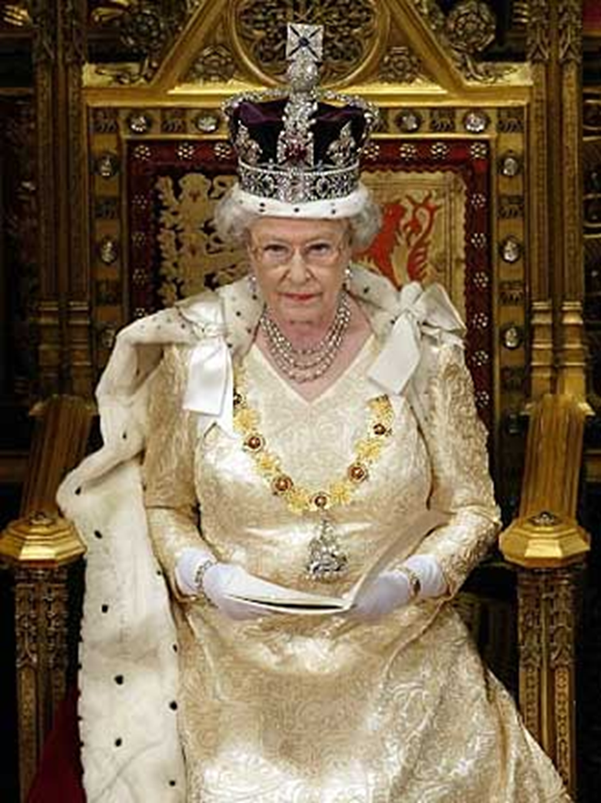
The sovereign reigns but does not rule.
Monarch is ‘advised’ by the government
Opens parliamentary session
Dissolves parliament
Bill -> law : Approval of the Queen, House of Commons and the House of Lords required.
In practice, parliament is supreme.
Royal assent= automatic
M. Bourdeau – UJML3

Slide 8
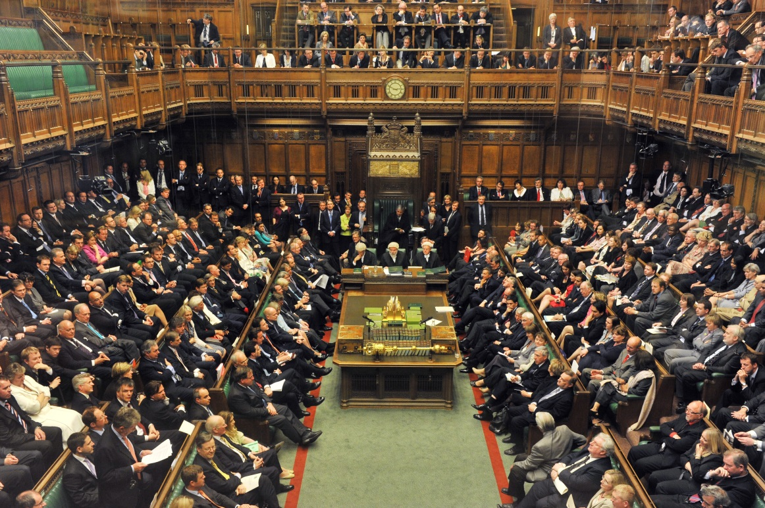
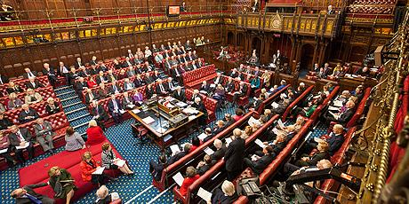
Legislative power
Bicameral legislature.
House of Commons (lower chamber)
House of Lords (upper chamber).
M. Bourdeau – UJML3

Slide 9
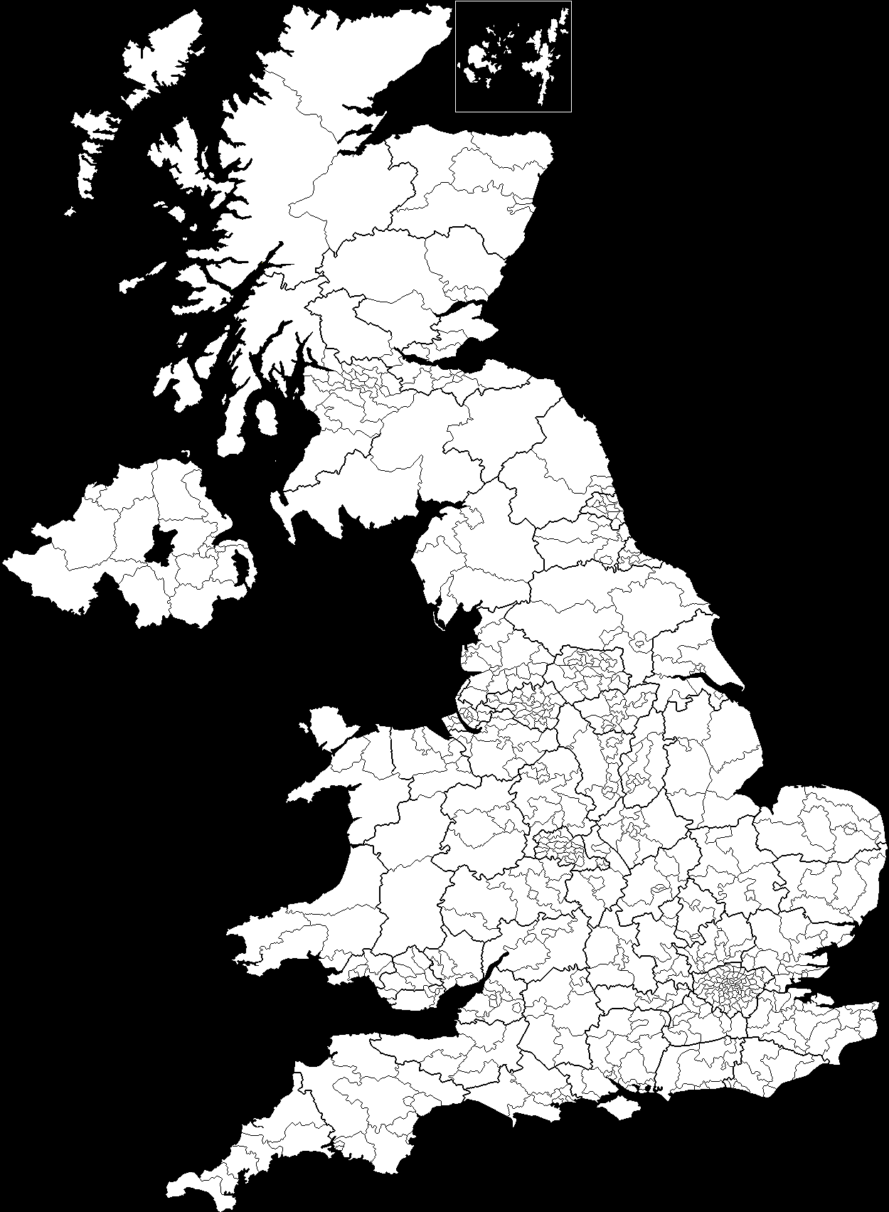
House of Commons (lower chamber)
650 Members of Parliament (MPs)
Elections:
Every 5 years
1 MP/ constituency
First-past-the-post system
M. Bourdeau – UJML3
Notes:
first-past-the-post (or winner takes all) electoral system = the candidate who receives the most votes wins

Slide 10
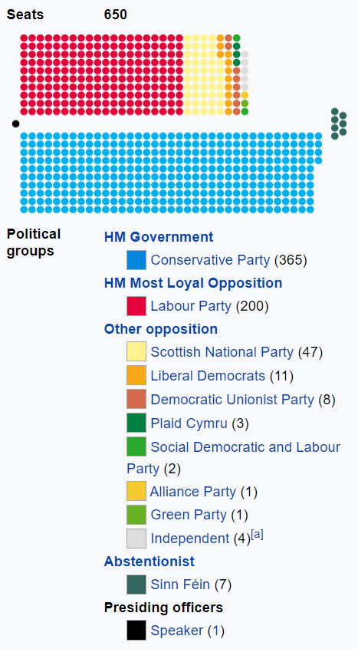
M. Bourdeau – UJML3

Slide 11
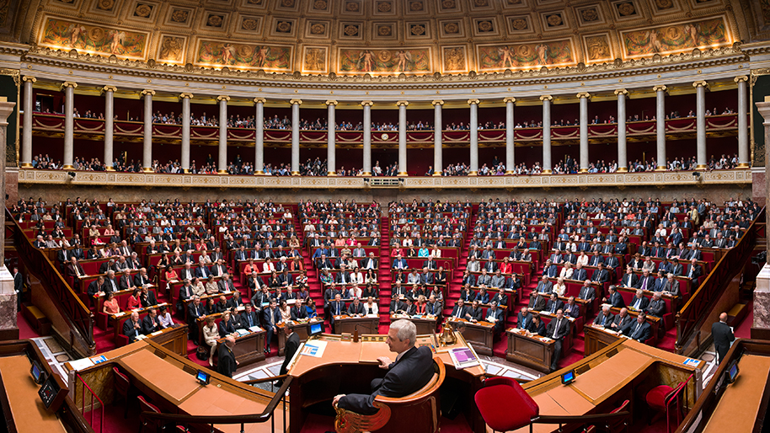

French Assemblée Nationale VS. British House of Commons
The UK = a two-party system? Historically yes; now a bit more nuanced
M. Bourdeau – UJML3

Slide 12
House of Lords
Not elected!
Inherit the title from your parent = hereditary peers
House of Lords Act of 1999
1,330 Lords => ~ 760.
Most lords now appointed by the Prime Minister /House of Lords appointment commission = life peers
Bishops (26)
M. Bourdeau – UJML3
Notes:
https://www.youtube.com/watch?v=RrQBTvRj0s8

Slide 13
1b. Main Political Parties in Britain
The English parliament = oldest in the world (1265)
Before the late 17th century, no political parties (members of parliament = aristocrats and wealthy men)
Exclusion Crisis (1679-1681) divided Parliament => most members formed into two parties, the Whigs and the Tories.
Tories
Rural areas
Strong monarch
Defense of royal absolutism
Passive obedience, no resistance
Whigs
Urban areas
Strong legislative power
Defense of Parliament power
Resistance, right to overthrow ruler
M. Bourdeau – UJML3

Slide 14
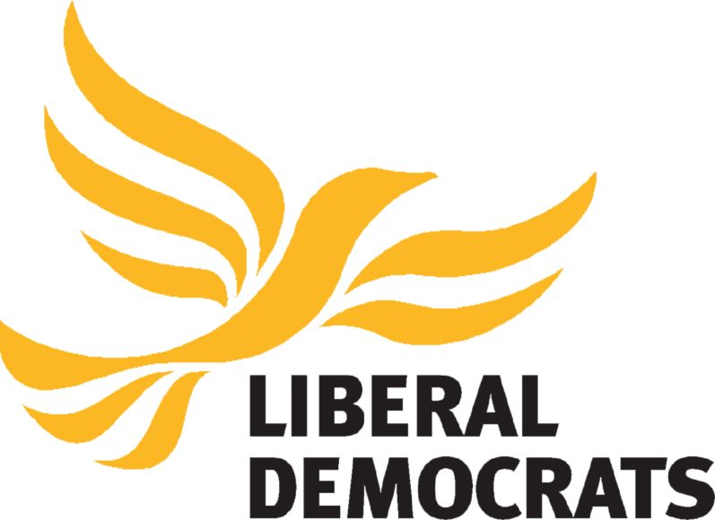
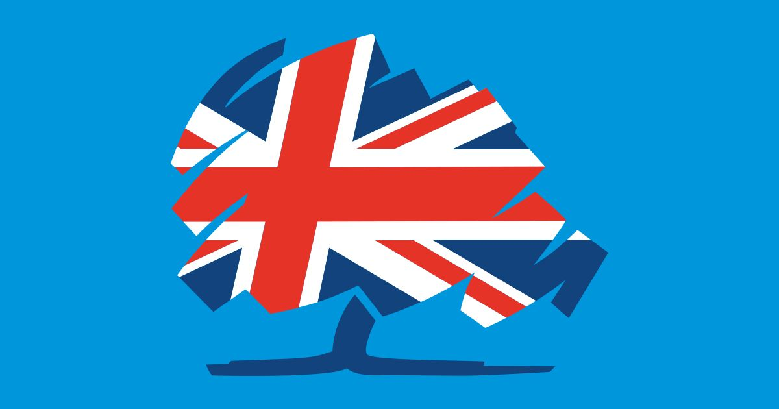
The Whigs = liberal and reforming aristocracy.
1850s: the Whig Party => the Liberal Party.
1989: the Liberal Party => Liberal Democrats.
Tories = supporters of strong royal power, i.e. monarchists and traditionalists.
1834: the Tory Party = the Conservative Party
M. Bourdeau – UJML3

Slide 15
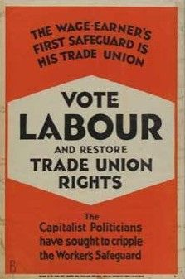
After WWI = Labour Party.
1929: Labour first majority.
= took over the Liberals as alternative to Conservatives
Rise of Labour = consequence of major changes in society at the time
After that, 2 (3?) main parties and not much change on the political stage in the 20th /early 21st centuries
M. Bourdeau – UJML3

Slide 16
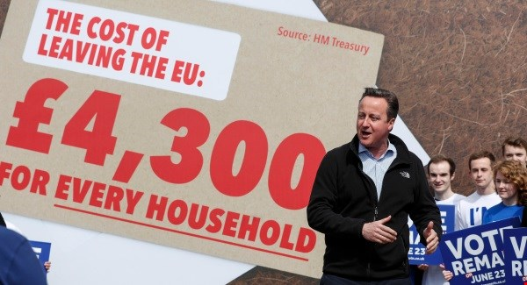
Conservative (and unionist) Party
British Party of the right
Free market
Law & order /Moral values (family and work)
Headed by Boris Johnson
since July 2019
Some major differences of opinions : wide political scope
Neoliberalists vs social conservatists
Eurosceptic vs Eurofriendly
M. Bourdeau – UJML3

Slide 17
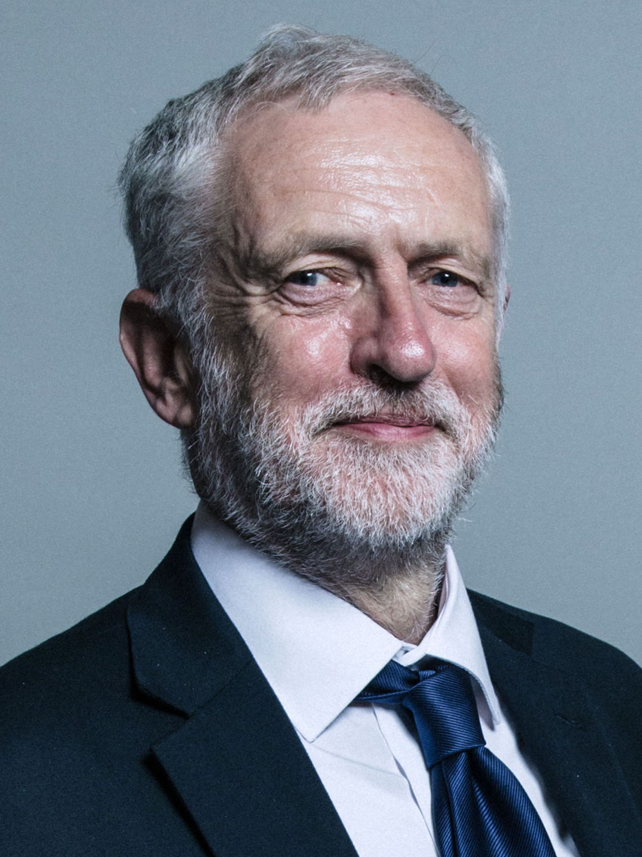
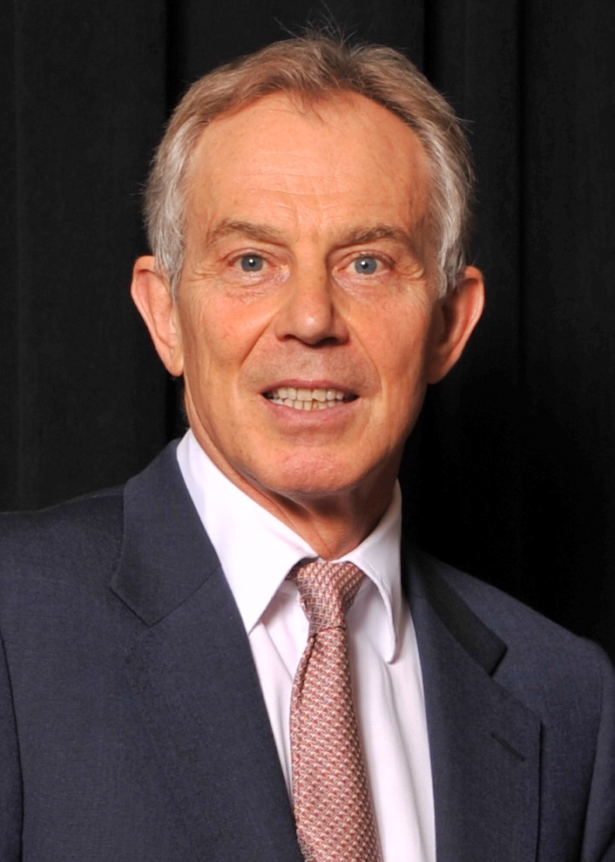
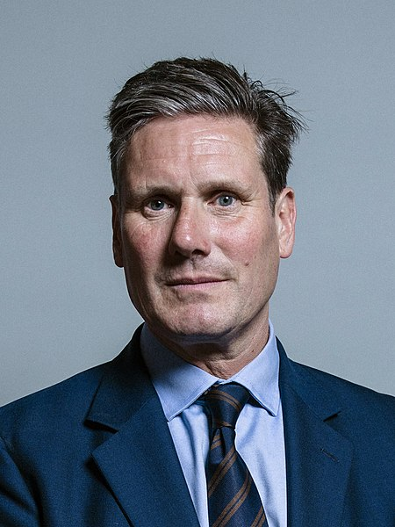
Labour Party
Left wing politics (socialism / link with trade unions)
Tony Blair’s leadership (1997-2007) = centre-left (New Labour).
Jeremy Corbyn (2015-2020) = return to core leftist, socialist values.
Keir Starmer (2020-?) = ‘soft left’ / ‘red-green’ Labour
M. Bourdeau – UJML3

Slide 18
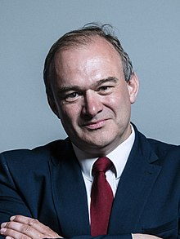
Liberal Democrats (or Lib Dems)
party of the centre
Most pro-European
2010-2015: coalition with the Conservatives (Nick Clegg)
Co-headed by Ed Davey since August 2020
M. Bourdeau – UJML3

Slide 19
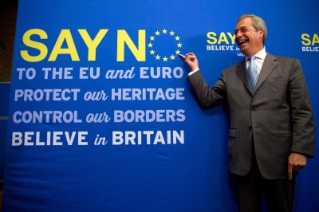
Pre 2016 : Controversy over immigration =>
Rise of the UK Independence Party (UKIP)
Political programme besides EU-bashing and xenophobia = ??
M. Bourdeau – UJML3

Slide 20
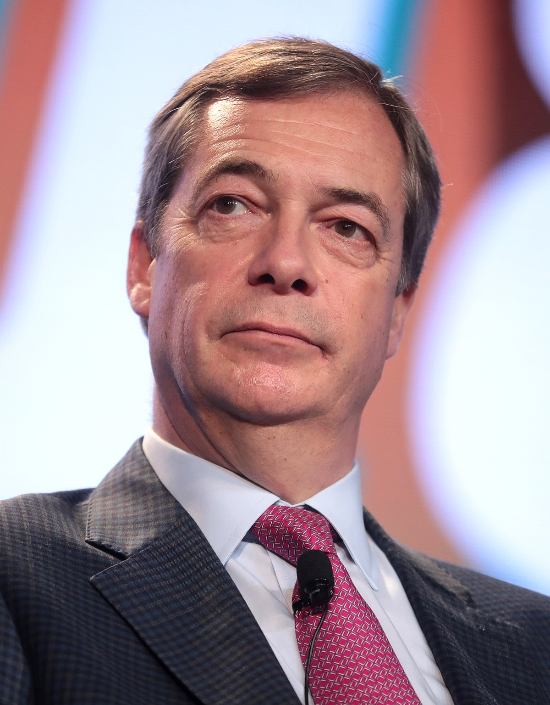
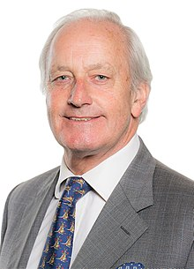
UKIP & Post-Brexit referendum :
- Nigel Farage out
(Current leader : Neil Hamilton, by interim)
Huge party crisis
0.1% votes in the Dec 2019 General election = lowest rate ever
M. Bourdeau – UJML3

Slide 21
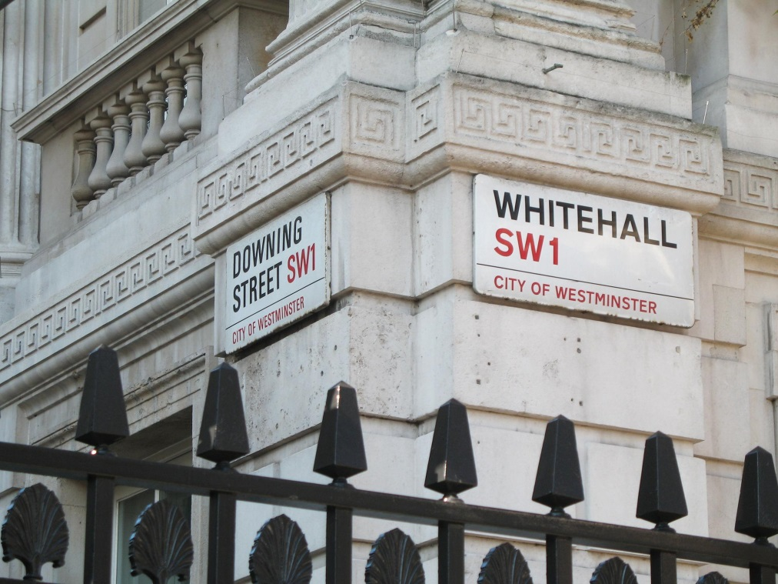
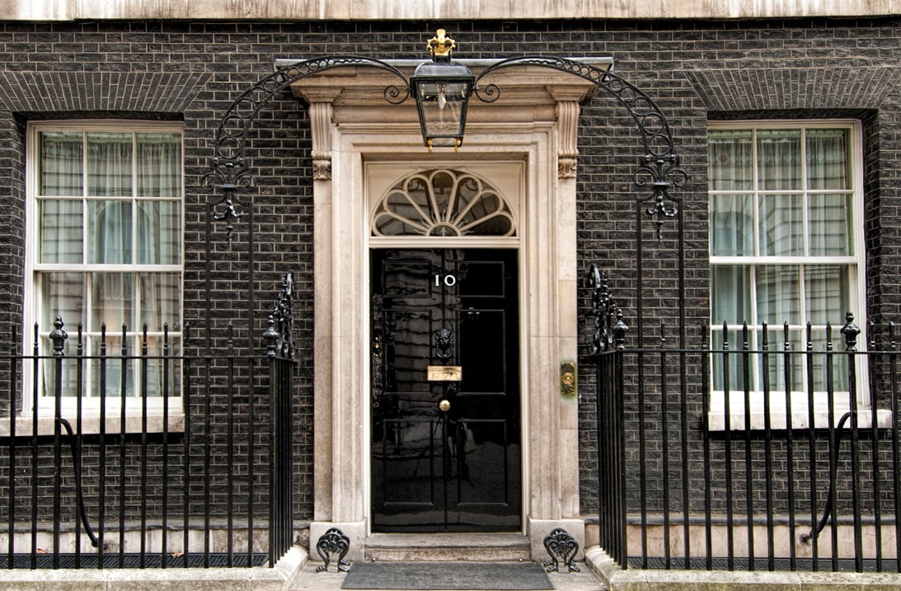
2. Whitehall
Whitehall = name of a street, south of Trafalgar Square
Refers to the British government / executive power
10 Downing Street
M. Bourdeau – UJML3

Slide 22
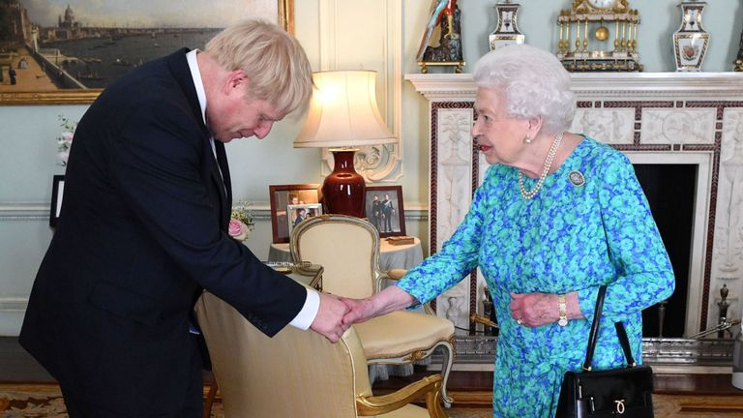
Prime Minister = head of the government ("Ministry")
Appointed by the sovereign
Appoints:
22 senior ministers
(= the Cabinet)
98 junior ministers
= 120 ministers
M. Bourdeau – UJML3

Slide 23

Members of the government & PM = necessarily elected MPs.
Front-benchers
Back benchers
M. Bourdeau – UJML3

Slide 24
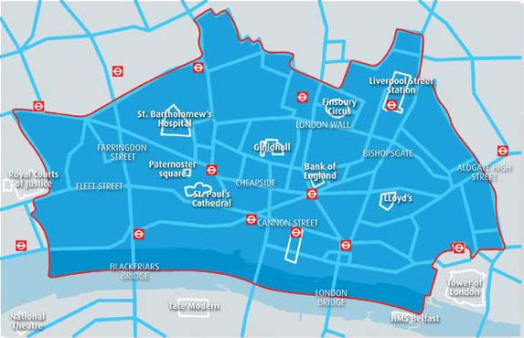
3. The City
= Financial district of London, located in the ‘Square Mile’
M. Bourdeau – UJML3

Slide 25
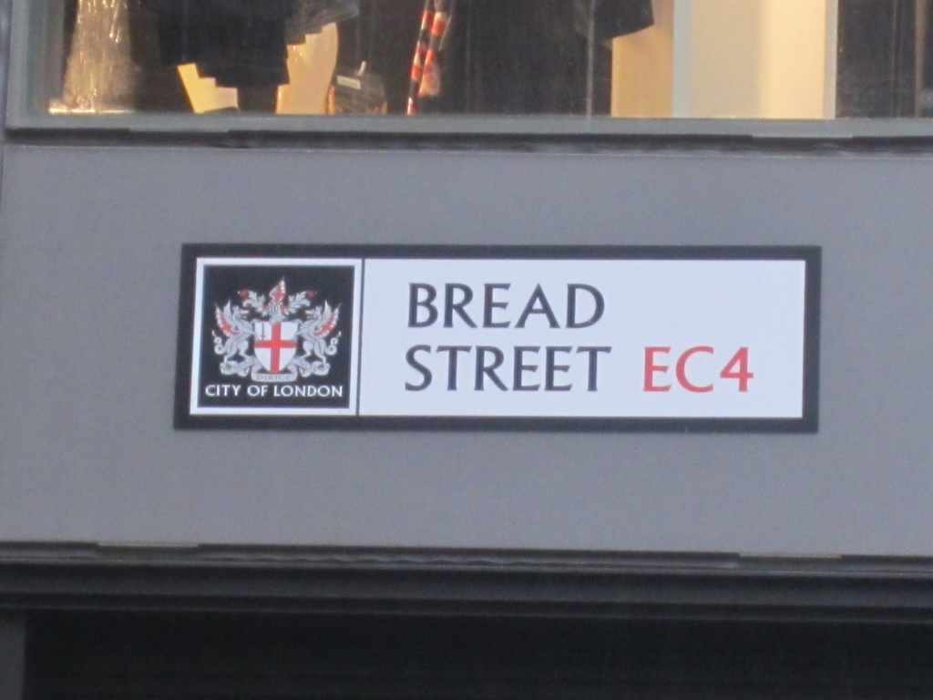
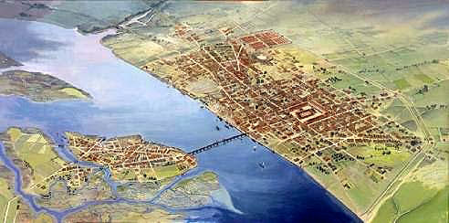
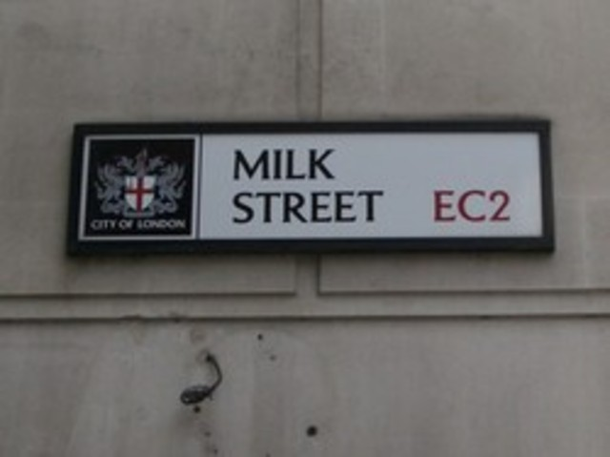
History
M. Bourdeau – UJML3
Established in around AD50
Londinium
Geographically strategic
Commerce and trade
Guilds

Slide 26
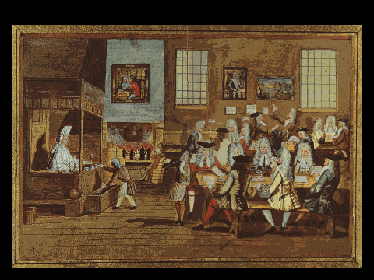
Early 17th century =
-> Guilds + major trade companies (ex the East India Company) had headquarters there.
-> Tradesmen gathered in coffee houses => gradually became financial institutions
M. Bourdeau – UJML3

Slide 27
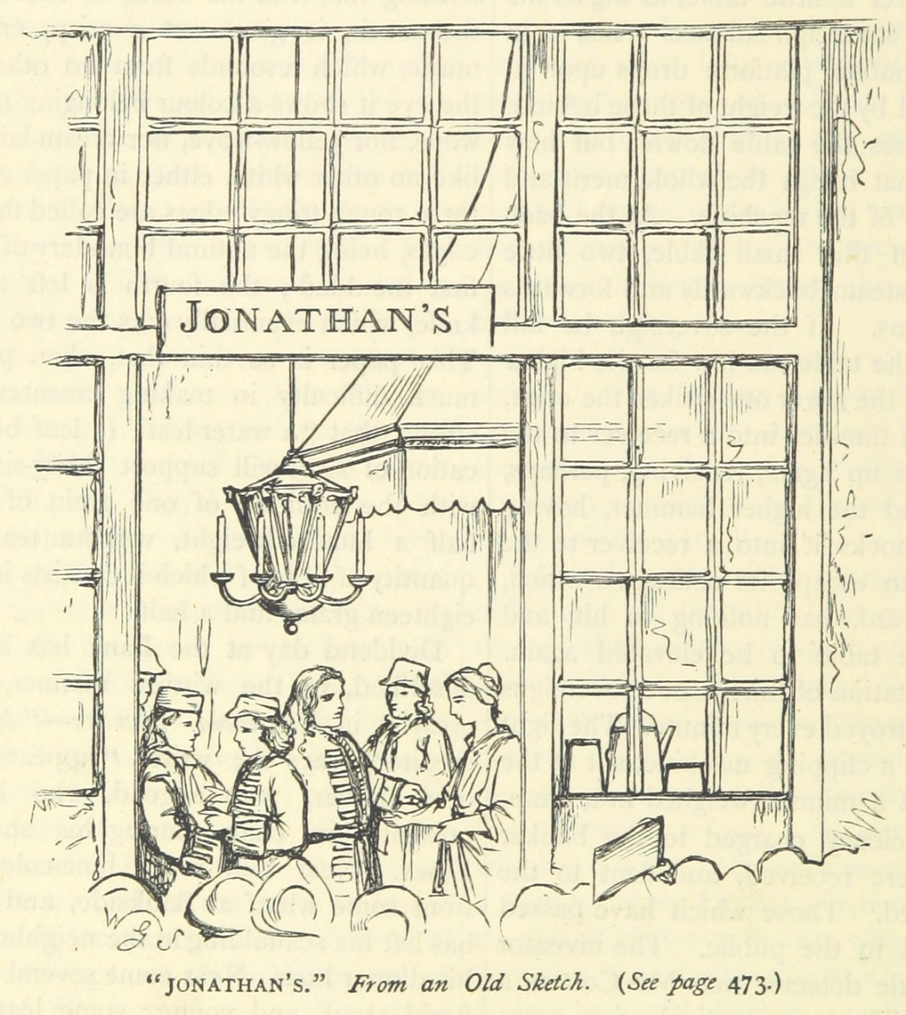
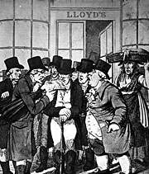
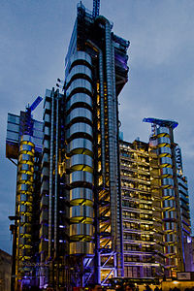
Jonathan’s Coffee House =>
London Stock Exchange
Lloyd’s coffee =>
Lloyd’s of London
M. Bourdeau – UJML3

Slide 28
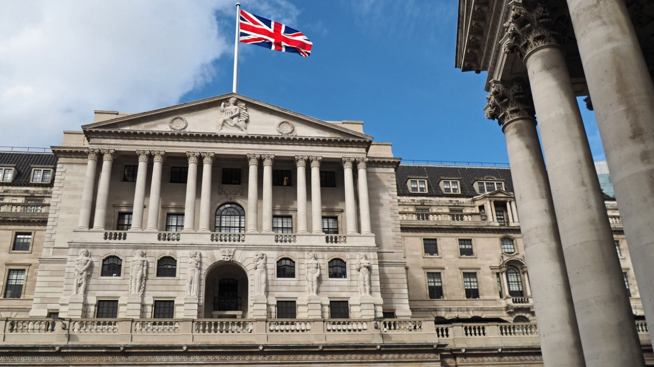
1694: founding of the Bank of England to regulate exchanges
1773 = “The Stock Exchange” coined.
1801 = official creation of the London Stock Exchange
1986: ‘Big Bang’: huge deregulation & structural/technological changes
Late 20th / early 21st = New York took over London as financial ‘capital’ of the world
M. Bourdeau – UJML3

Slide 29
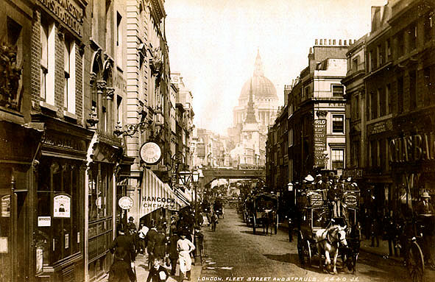
The fourth power: the Press (‘Fleet Street ’)
HQ of the British national Press since 16th century
Tabloids
vs.
Broadsheets
Mostly working class readership
Selling sensational “news”
Poor quality press
The Sun, The Daily Mail, The Daily Mirror
Middle class readership
Reporting about current topics & issues
Good quality press
The Times, The Daily Telegraph, The Guardian
M. Bourdeau – UJML3

Slide 30
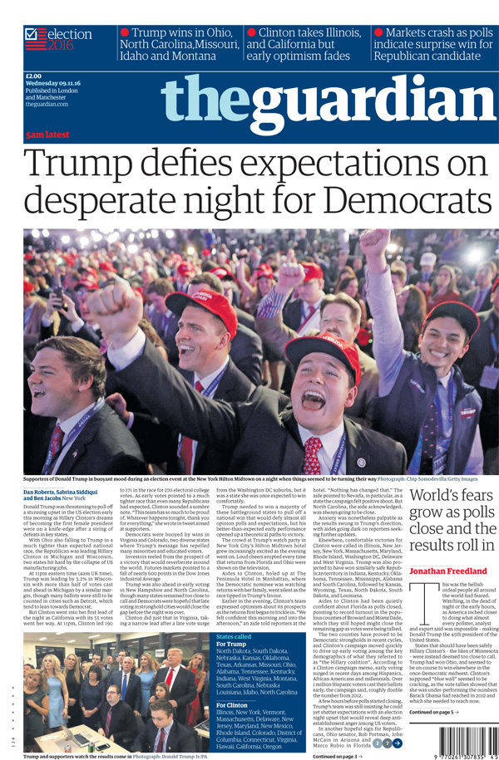
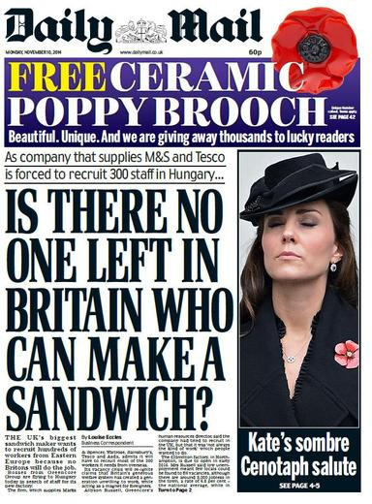
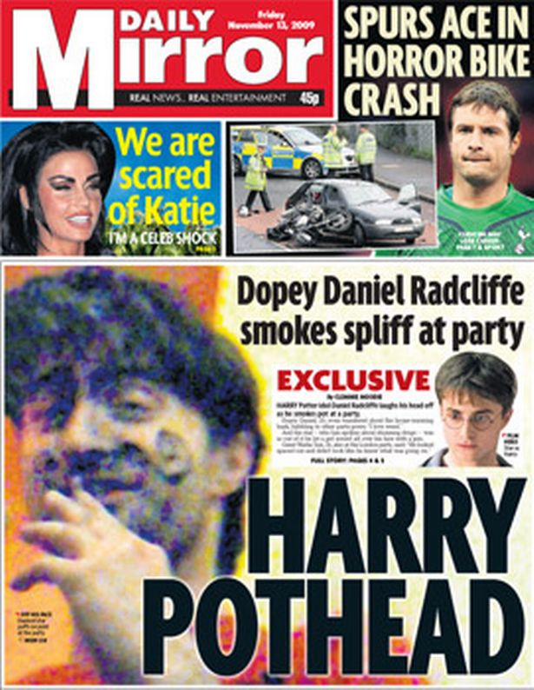
Broadsheet (quality press)
Tabloids (popular press)
M. Bourdeau – UJML3

